Slide 1

RAIN PREDICTION

Slide 2
INTRODUCTION
Rainfall has a significant impact on society. Festivals, all sorts of activities, and sports matches are examples of events that could be heavily influenced by rainfall.
The goal of this analysis is to predict if it is going to rain the next day, based on the weather measures of the day before using Machine Learning
This creates a binary classification problem (1 = Rain and 0 = No Rain). The dataset consists of weather data in Australia over 10 years (1 Nov 2007 to 25 Jun 2017).
The dataset contains total 145460 rows and 23 columns
Rain Tomorrow is the target variable to predict. It means -- did it rain the next day, Yes or No? This column is Yes if the rain for that day was 1mm or more
How Rain Tomorrow will be related to other features
Best and Effective Machine Learning algorithm

Slide 3
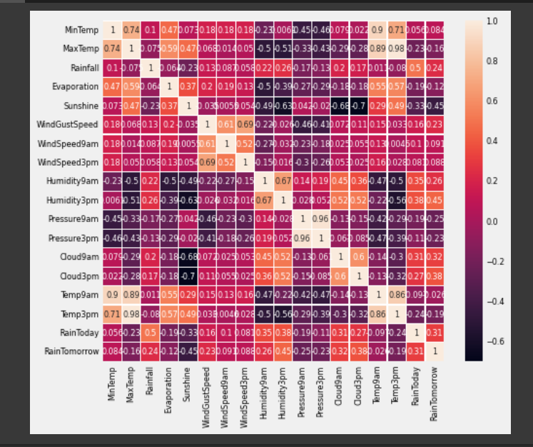
We can see the Target 'Rain Tomorrow is corelated to Rain Today ,cloud 9 am, cloud 3 am, Humidity 3 pm and negatively corelated to sunshine, these corelated features makes significant roles in prediction

Slide 4
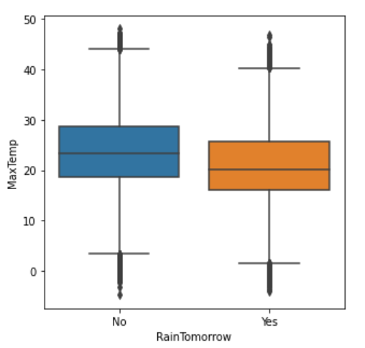
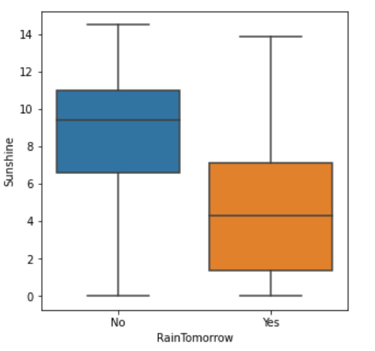
WindGust speed analysis
we can see avg temperature's will be less when there is raining there are outliers (-5) in boxplot where Rain is No after which means there where days which went extreme cold
We can see when there is rain sunshine will be less than when there is no rain, it can also says most of the rain can occur at night time and there are not outliers

Slide 5
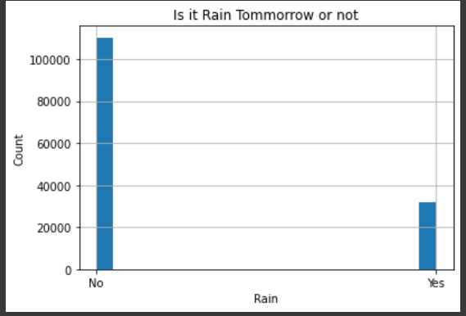
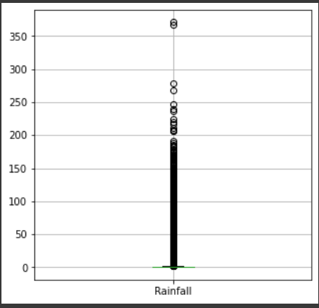
Analysis of Target Variable
we can see there are outliers in the distribution of rain fall there values after 371mm, so those days will be heavy rain, and most of the values including avg vale lies 2.71 mm
The above Histogram say’s the ‘NO’ is more
than ‘Yes, so we can say that chance for Tomorrow is less

Slide 6
Machine Models and accuracy
LOGISTIC
Regression
Accuracy of Test Data = .84433
Accuracy of Train Data = .84463
XGB Classifier
Random Forest classifier
Accuracy of Test Data = .856
Accuracy of Test Data = .8652
Accuracy of Train Data = .8844
Accuracy of Train Data = .99

Slide 7
The best Model
It is Highly Flexible
It uses the power of parallel processing
XGB CLASSIFIER
Test Accuracy is higher than other two models
Less overfitting compared to other model
Predicting time is less compared to other models –more faster
Highly Flexible
It uses the power of parallel Processing
The user can run a cross-validation after each iteration.

Slide 8
Thank you
JOBIN JOSE
jjobin9660@gmail.com
Github: https://github.com/JobinJose9660/Rain-Prediction/blob/main/Rain_Prediction.ipynb

